Slide 1
Solving problems with AI/ML

Slide 2
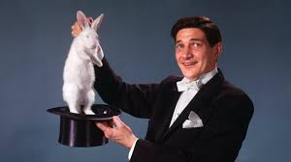
Story of the Magician

Slide 3
Contents
Identifying your customer’s problem
Analytics Protocol and AI/ML
What is a Model?
When to use what models
How to choose the best model
How to explain a model to your customers

Slide 4
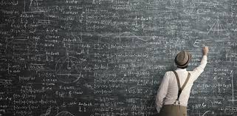
1. What is the real problem?

Slide 5
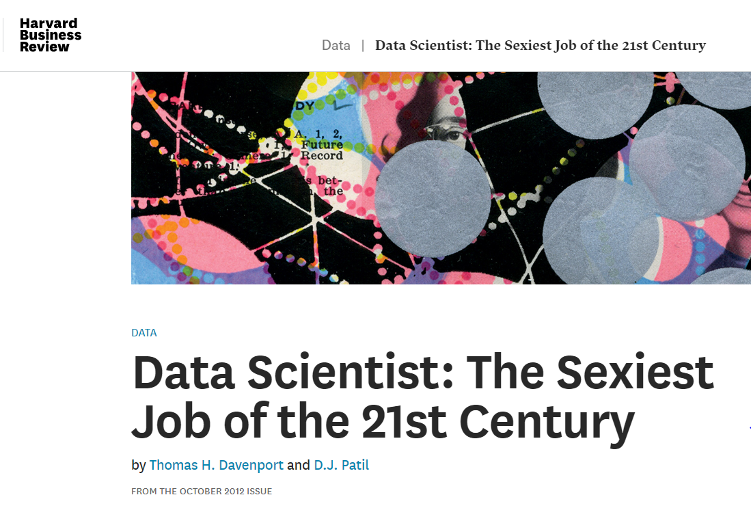

What should be an AI/ML solution?
AI/ML is hot.
Temptation is to use AI/ML to solve every problem
First ask: “Is this an AI/ML problem?”

Slide 6
Steps to decide if this is an AI/ML problem?
Possible AI/ML Solution
Define the Problem
N
Need patterns or predictions?
Y
Is the problem simple?
Y
N
Not AI/ML Problem

Slide 7
Is this an AI/ML problem?
Sales for last quarter were down 12%. There is a theory that the trade war with China and subsequent tariffs were the cause. The business asked for a Machine Learning model to understand the historical correlation between tariffs and sales.
The UK parliament recently approved Brexit. The UK economic indicators have declined slightly over the past two years. The uncertainty caused by this event has caused sales in the UK to decline by 15%. The business asked for a Machine Learning model to understand if sales have reached the bottom or if they will continue to decline further due to a possible recession.
The upcoming American election contains candidates threatening to raise taxes significantly. There is concern that this would impact auto sales. The business asked for a Machine Learning model to understand the relationship between taxes and auto sales.

Slide 8

Great questions to ask
What is the business problem being solved?
What is the purpose of a possible model?
What business questions would the model help answer?
Can you answer the questions without an AI/ML model?
What actions should be taken based on the answers?
Who will use the model?
For what purposes will they use the model?
Not every problem requires an AI/ML solution

Slide 9

2. How does the Analytics Protocol help?

Slide 10
Analytics Protocol
Problem Formulation
Data Management
Development
Deployment
Management
Understand the business problem
Check if there is related work that was completed or in the process of being developed in GDIA
Discuss alternate analytic methods
Ensure that solution can be integrated into business process
Structure the business problem for analytic solution
Obtain Information/data relative to the analytic model to be made Collect the data Understand the data and make sure data definitions match the business operational definitions Prepare the data
Evaluate, select, and implement analytic methods Validate – out of sample/time validation Assess uncertainty
Present predictions/ forecasts Consider “Spread” (i.e. consider how this analytic solution can be utilized in other areas) Be clear on the assumptions and limitations on the model so that it is used for the correct purpose
Learning that will improve prediction/ forecast procedures Monitoring the prediction/forecasting process
Keep good records
How does each of these steps impact an AI/ML solution?

Slide 11

3. What is a Model?

Slide 12

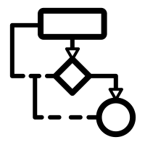


Machine Learning Ecosystem
The model applies an algorithm on a problem using the available data
Model
The algorithm is the set of rules to solve the problem
Algorithm
Problem
Data

Slide 13

Definition of a Model
A machine learning model can be a mathematical representation of a real-world process. ... The learning algorithm finds patterns in the training data such that the input parameters correspond to the target. The output of the training process is a machine learning model which you can then use to make predictions.
Math
Real-world process
Patterns
Predictions

Slide 14
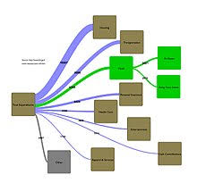
4. When do I use what models?

Slide 15
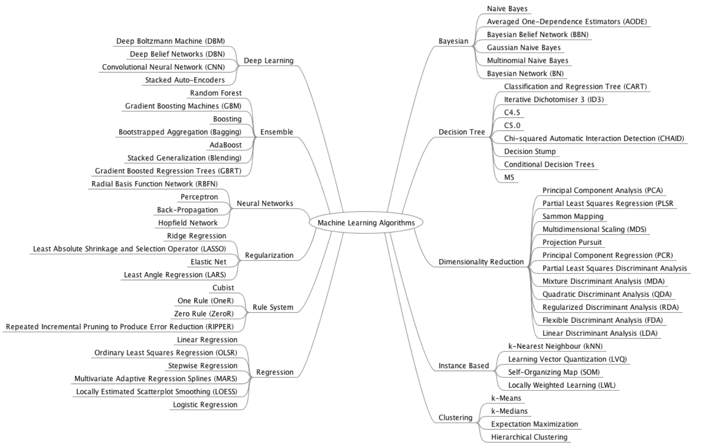
Types of models
https://towardsdatascience.com/which-machine-learning-model-to-use-db5fdf37f3dd

Slide 16

Focus on Key Model Approaches
Regression
Regularization
Decision Tree
Bayesian
Clustering
Association Rules
Artificial Neural Networks
Deep Learning
Dimensionality
Ensemble
https://machinelearningmastery.com/a-tour-of-machine-learning-algorithms/

Slide 17
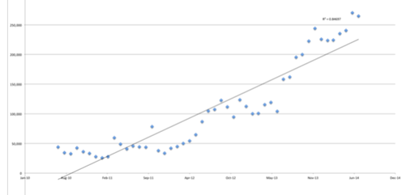
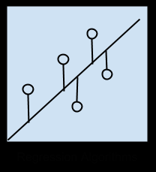
1. Regression Models
Regression is concerned with modeling the relationship between variables that is iteratively refined using a measure of error in the predictions made by the model.
Focuses on best fit

Slide 18
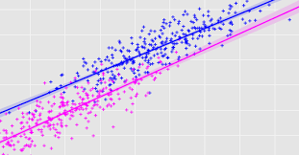
About regression analysis
When to use:
Predicting one dependent variable (target) with many independent variables
Used for forecasting, time series and causal effect relationships
Benefits:
Most common and easy to understand
Gives output as an equation
Indicates significant relationships between target and independent variables
Indicates strength of impact of multiple variables on the target

Slide 19
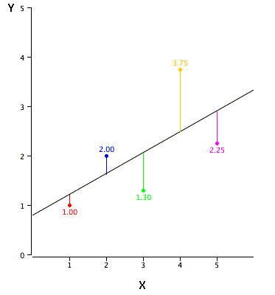
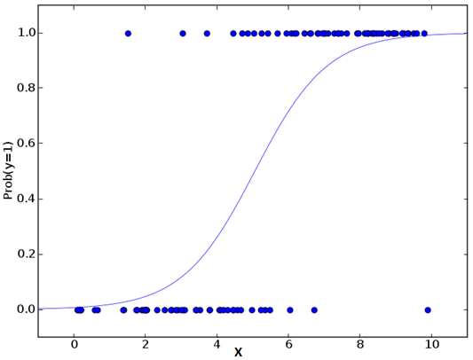
Major Types of Regression Models
Linear Regression:
Creates an equation resulting in the predicted value
Need to select only statistically relevant independent variables
Best fit approach to minimize error
Predicted value will be a numerical value
Great for forecasting
Logistic Regression:
Creates a log-based equation resulting in the predicted value
Need to select only statistically relevant independent variables
Best fit approach to minimize false values
Predicted value will be true or false
Great for classification

Slide 20
Linear or Logistic?
The business team is getting ready for the new 2020 Explorers. They want to build a model to predict what the suggested price and discount should be.
The business team is looking at leases up for renewal or not. They want to build a model to predict whether or not we want to make an offer to the person to renew.
Finance is concerned about fraudulent travel expenses but they do not have the resources to audit every single expense report. They want to build a model to decide which expense reports should be audited.
Dealer rebates cost the company a lot of money. They want to know what level of rebates they should offer on the 2020 Edge so increase sales by 10%.

Slide 21
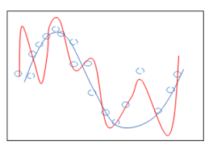
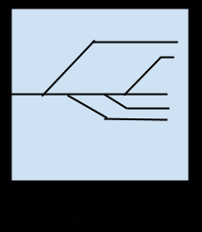
2. Regularization Models
An extension made to a regression method that penalizes models based on their complexity, favoring simpler models that are also better at generalizing.
Penalizes, dampens and smooths

Slide 22
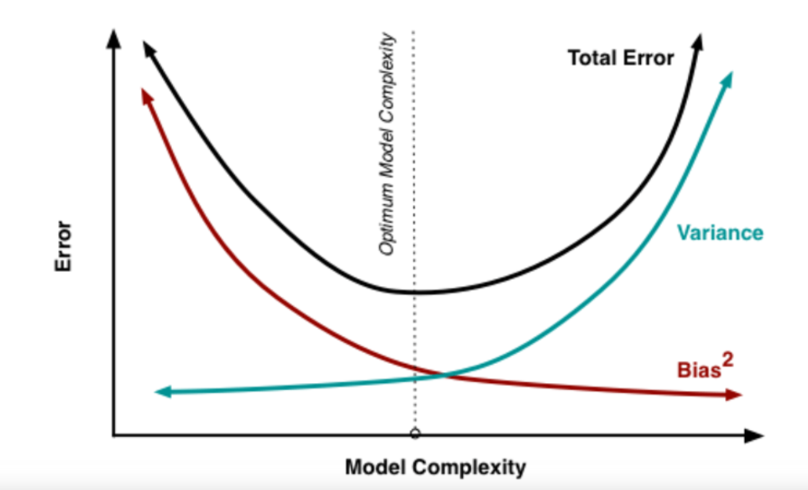
Major Types of Regularization Models
Ridge Regression:
Used with multi-collinear data
Adds shrinkage parameter to penalize variance
Requires tuning
Lasso Regression:
Least Absolute Shrinkage and Selection Operator
Builds on ridge and penalizes actual size of regression coefficients
Reduces variability and improves accuracy
Requires tuning
Elastic Net Regression:
Hybrid of Ridge and Lasso
Useful when there are multiple features which are correlated
Requires tuning

Slide 23
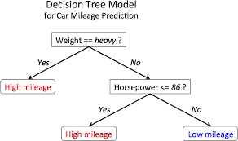
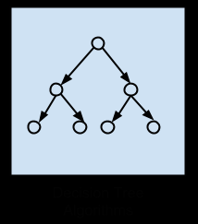
3. Decision Trees Models
Decision tree methods construct a model of decisions that fork in tree structures until a prediction decision is made for a given record. Decision trees are trained on data for classification and regression problems. Decision trees are often fast and accurate
Branches based on comparison

Slide 24
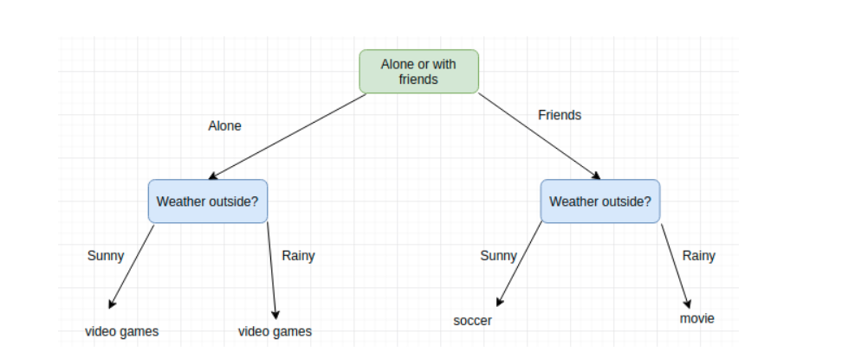
Example of a real decision
What should I do this weekend?
https://towardsdatascience.com/a-guide-to-decision-trees-for-machine-learning-and-data-science-fe2607241956

Slide 25

How does a decision tree work?
1. Induction
Successively decide best features to split on, then determine which values to build into subsets to maximize accuracy and minimize splits/nodes
In Michigan you would need a third split for weather - snowing
https://towardsdatascience.com/a-guide-to-decision-trees-for-machine-learning-and-data-science-fe2607241956

Slide 26
How does a decision tree work?
2. Pruning
Decide limits on the number of options in the split
You could add sunny, cloudy, partly cloudy, drizzle, rain, thunderstorm, tornado, hurricane, snow flurry, ice storm, blizzard, steady snow, etc.
Eliminate redundancy
https://towardsdatascience.com/a-guide-to-decision-trees-for-machine-learning-and-data-science-fe2607241956

Slide 27

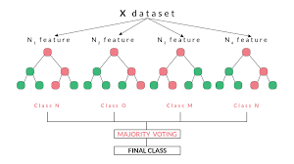
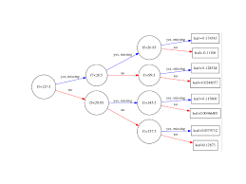
Major Types of Decision Tree Models
Decision Tree
A tree is built by splitting the source set, constituting the root node of the tree, into subsets - which constitute the successor children. The splitting is based on a set of splitting rules based on classification features
Random Forest
Random forest is an ensemble method that operates by constructing a multitude of fully grown decision trees in parallel (low bias, high variance)
Gradient Boosting
Gradient Boosting is an ensemble method that builds many shallow trees in succession (high bias, low variance)

Slide 28
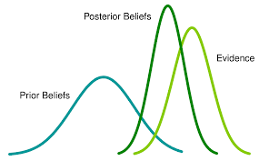
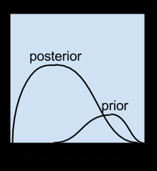
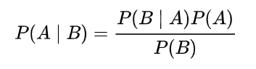
4. Bayesian Models
Bayesian methods are those that explicitly apply Bayes’ Theorem for problems such as classification and regression.
Built on Bayesian statistics

Slide 29
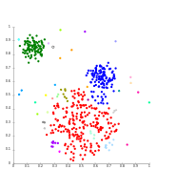
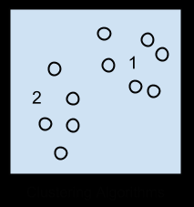
5. Clustering Models
Clustering models are typically organized by the modeling approaches such as centroid-based and hierarchal. All methods are concerned with using the inherent structures in the data to best organize the data into groups of maximum commonality.
Organized by Likeness

Slide 30
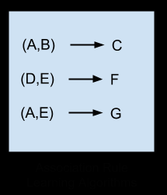
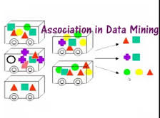
6. Association Rules Models
Association rule learning methods extract rules that best explain observed relationships between variables in data. These rules can discover important and commercially useful associations in large multidimensional datasets that can be exploited by an organization.
Creates rules for patterns

Slide 31
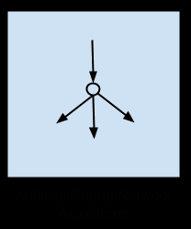
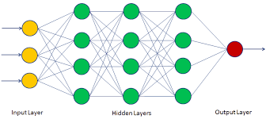
7. Artificial Neural Network Models
Artificial Neural Networks are models that are inspired by the structure and/or function of biological neural networks. They are a class of pattern matching that builds subfields comprised of hundreds of algorithms and variations for all manner of problem types.
Builds layers of computation

Slide 32
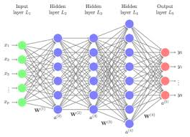
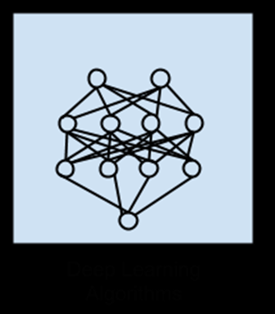
8. Deep Learning Models
Deep Learning models build Neural Networks that can exploit abundant cheap computation. They are concerned with building much larger and more complex neural networks and are often concerned with very large datasets of labelled analog data, such as image, text. audio, and video.
Complex ANN

Slide 33
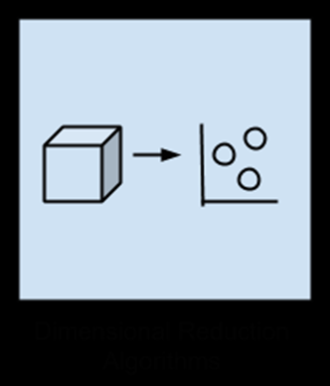
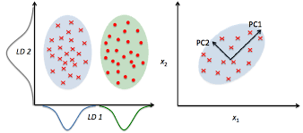
9. Dimensionality Reduction Models
Like clustering methods, dimensionality reduction models seek and exploit the inherent structure in the data, but in this case in an unsupervised manner or order to summarize or describe data using less information.
Combines and reduces variables

Slide 34
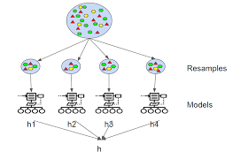
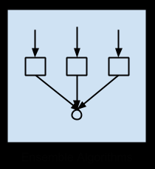
10. Ensemble Models
Ensemble methods are models composed of multiple weaker models that are independently trained and whose predictions are combined in some way to make the overall prediction.
Combines multiple models

Slide 35
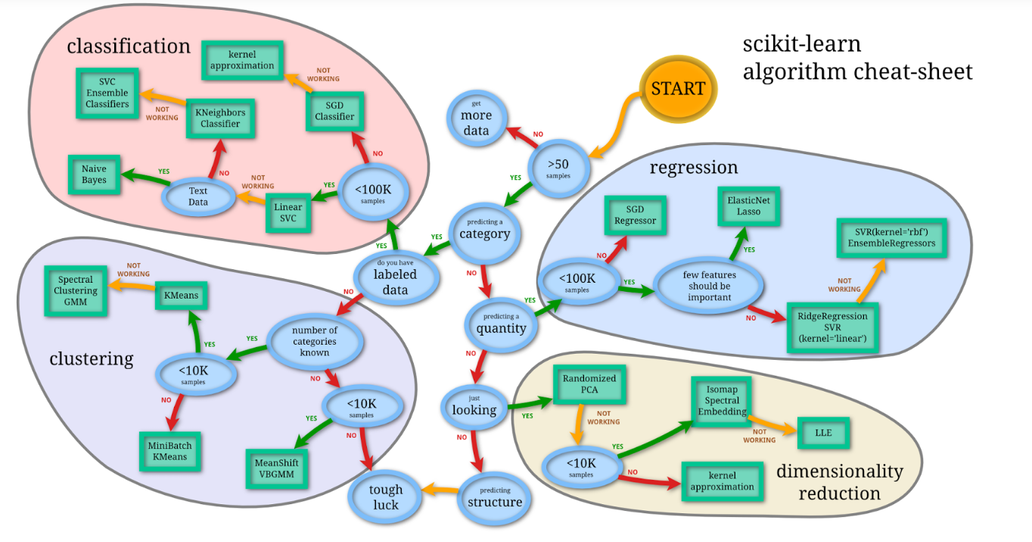
When to use what model
https://towardsdatascience.com/which-machine-learning-model-to-use-db5fdf37f3dd

Slide 36

5. How do I pick models?

Slide 37

Measuring fit
How do I know which model to use? Based on Fit
Model fit is how close the model predicted the results as compared with reality
Better fit = Better model
There are several methods of measuring fit
Depends on:
Use case
Model type
As part of the fitting you must select your variables

Slide 38
How do I pick variables?
Hypothesis test for each variable
Hypothesis (H): Unemployment impacts sales (correlation)
Alternative Hypothesis (H₀): Unemployment has no impact on sales (no correlation)
P Value: Tests the null hypothesis. If less than significance level you reject the null hypothesis (correlation is statistically significant)
Bottom Line: If P Value is < 0.05 the variable has an impact on the predicted value and should be used

Slide 39
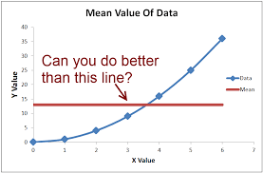
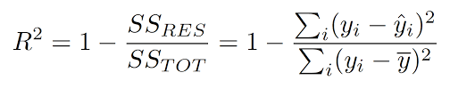
How do I pick the best fit for linear regression models?
R-squared
Measures fit by showing percentage of variance is explained by the independent variables in the model
<0.70 bad fit
0.70- 0.85 questionable fit
>0.85 good fit
Relative measure of fit

Slide 40
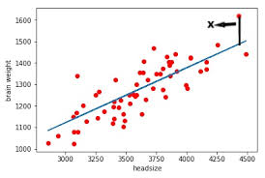
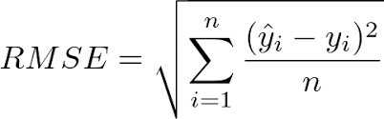
How do I pick the best fit for linear regression models?
RMSE (Root Mean Squared Error)
Measures by showing how spread out the residuals are (tells you how concentrated the data is around the line of best fit)
When comparing models the smallest value is a better fit
Absolute measure of fit

Slide 41
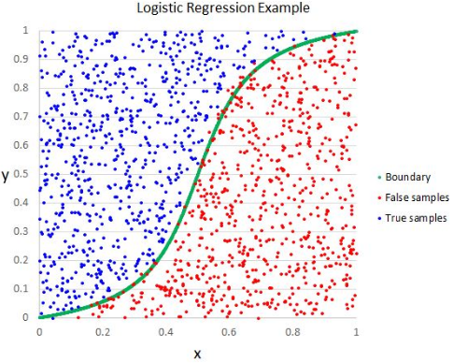
How do I pick the best fit for logistic regression models?
Confusion Matrix
Accuracy
Precision
Sensitivity
Specificity
AUC
Logistic Loss

Slide 42
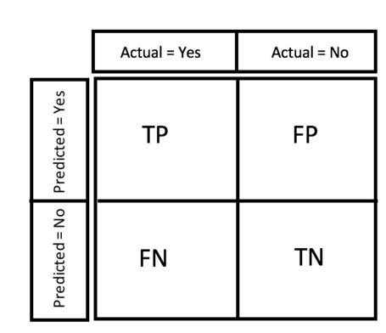
For analysis with a true/false output: Confusion Matrix
True Positives (TP): when reality was True and the predicted is also True
True Negatives (TN): when reality was False and the predicted is also False
False Positives (FP): when reality was False and the predicted is True.
False Negatives (FN): When reality was True and the predicted is False.

Slide 43
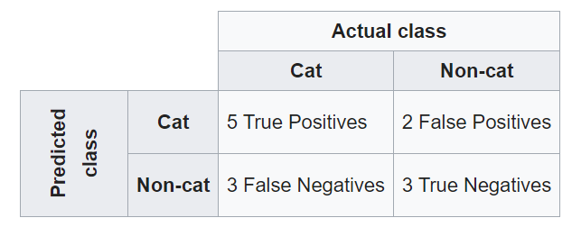
Confusion Matrix Example
You give a model 13 pictures of animals: 8 cats and 5 dogs. Goal is to accurately identify the cats.
13 animals predicted
https://en.wikipedia.org/wiki/Confusion_matrix

Slide 44
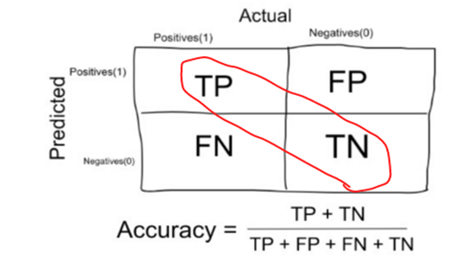
Accuracy
Cat Example:
(5 +3)/13 = 0.615
Accuracy of Model is 61.5%
Accuracy focuses on how true the model is
Useful when the true and not true are balanced

Slide 45
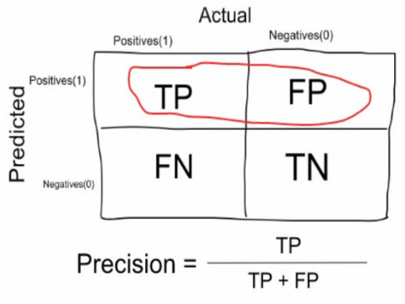
Precision
Cat Example:
5/(5+2) = 0.714
Precision of Model is 71.4%
Precision focuses on the correctness of positive predictions
Useful when the negative predictions are less important

Slide 46
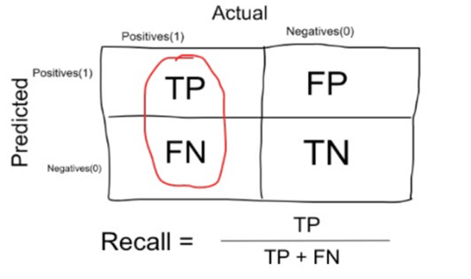
Sensitivity
Cat Example:
5/(5+3) = 0.625
Sensitivity of Model is 62.5%
Sensitivity focuses on the correctness of the actual positives
Useful when the correctness of actual negatives are less important

Slide 47
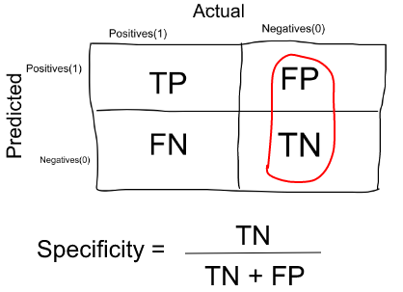
Specificity
Cat Example:
3/(2+3) = 0.600
Specificity of Model is 60.0%
Precision focuses on the impact of the actual negatives
Useful when the actual positives are less important

Slide 48
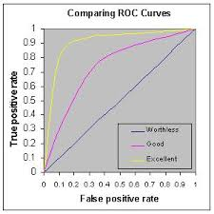
ROC and AUC
ROC (Receiver Operating Curve)
a graphical plotting of the true positive rate against the false positive rate at various threshold settings.
AUC (Area Under Curve)
Probability that a classifier will rank a randomly chosen positive instance higher than a randomly chosen negative one
Values closer to 1 are best
0.5 means random

Slide 49
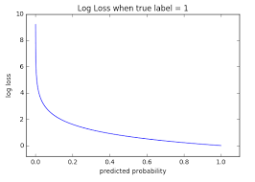
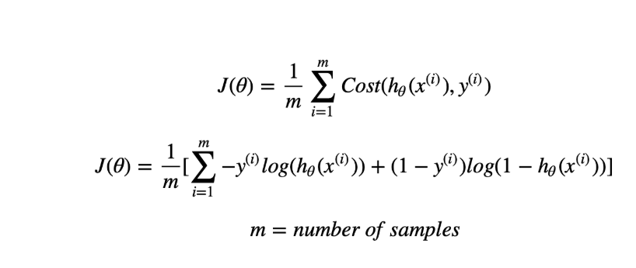
Logistic Loss
Takes into account the probabilities underlying your models, and not only the final output of the classification
Values closer to 0 are best
0.693 is non-informative

Slide 50

6. How to Communicate My Results?

Slide 51
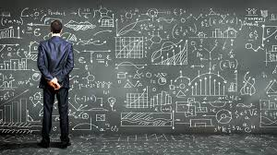


The Challenge of AI/ML Communication
Our greatest challenge:
What we see
What they need to see
We need to explain the model so they understand

Slide 52

Surveys reveal
94% of business executives think that AI/ML is important to solving strategic challenges - 2018 Economist Survey
82% of organizations have not adopted AI/ML beyond Proof of Concept - 2018 MIT Sloan Management Review Study
Key Issue: Trust due to possible bias and inability to explain (“black box”)
towardsdatascience.com/people-dont-trust-ai-we-need-to-change-that-d1de5a4a0021

Slide 53



Process
Audience Analysis:
Who are they?
How technical are they?
Message Analysis:
What do they need to know?
3. Trust Analysis:
Bias: Use reliable and trusted data sources
Explainability:
Use visualization
Explain the validation
Don’t use only technical terms
Tie to business need
Tell the story of the results
Analyze the needs of the audience, the message and how to increase their trust

Slide 54
Summary
Identifying your customer’s problem
Analytics Protocol and AI/ML
What is a Model?
When to use what models
How to choose the best model
How to explain a model to your customers

Slide 55


Santa Claus and the Easter Bunny

Slide 56

Impact of DataRobot

